Slide 1
DataStax AlwaysOnSQL Intro
© 2018 DataStax, All Rights Reserved. DataStax is a registered trademark of DataStax, Inc. and its subsidiaries in the United States and/or other countries. Apache Cassandra, Apache, Spark, and Cassandra are trademarks of the Apache Software Foundation or its subsidiaries in Canada, the United States and/or other countries.
Notes:
Welcome to the DataStax AlwaysOnSQL workshop.

Slide 2
Agenda
Time | Topic
1:00 | Introductions
1:15 | Overview of DataStax Enterprise
1:35 | Just Enough Internals
1:50 | The Reference Application
1:55 | Accessing the Instances
2:00 | Lab 1
Time | Topic
2:30 | Lab 2
2:50 | Lab 3
3:10 | Lab 4
3:30 | Going Deeper
3:35 | Discussion
B
R
E
A
K
Notes:
Here is our agenda (NOTE that the actual times may have to be changed, depending on the specific workshop needs).
We’ll begin by getting to know each other a little. Then we’ll provide a level-set on DataStax Enterprise, or DSE, for those who are new to the platform (NOTE: this is a separate deck, available on Gdrive in the same directory as this deck). Then I’ll introduce the bare minimum we’ll need to understand about DSE and AlwaysOnSQL internals. We’ll talk briefly about our imaginary reference application. Then we’ll take a brief tour of the resources we’ll be using today, including our Cluster Instance and DSE Notebooks.
From there we’ll jump into four Lab exercises, where you’ll be hands-on with the product, and we’ll wrestle with some real-world AlwaysOnSQL problems.
After the labs I’ll share some useful links, and we’ll end the day with discussion about anything that is top-of-mind for you.

Slide 3
Agenda
Time | Topic
1:00 | Introductions
1:15 | Overview of DataStax Enterprise
1:35 | Just Enough Internals
1:50 | The Reference Application
1:55 | Accessing the Instances
2:00 | Lab 1
Time | Topic
2:30 | Lab 2
2:50 | Lab 3
3:10 | Lab 4
3:30 | Going Deeper
3:35 | Discussion
B
R
E
A
K
Notes:
Here is our agenda (NOTE that the actual times may have to be changed, depending on the specific workshop needs).
We’ll begin by getting to know each other a little. Then we’ll provide a level-set on DataStax Enterprise, or DSE, for those who are new to the platform (NOTE: this is a separate deck, available on Gdrive in the same directory as this deck). Then I’ll introduce the bare minimum we’ll need to understand about DSE and AlwaysOnSQL internals. We’ll talk briefly about our imaginary reference application. Then we’ll take a brief tour of the resources we’ll be using today, including our Cluster Instance and DSE Notebooks.
From there we’ll jump into four Lab exercises, where you’ll be hands-on with the product, and we’ll wrestle with some real-world AlwaysOnSQL problems.
After the labs I’ll share some useful links, and we’ll end the day with discussion about anything that is top-of-mind for you.

Slide 4

Just Enough Internals
Primary keys – C* vs SQL
What is Spark?
How does Spark work?
Why is Spark important in DSE?
How does AlwaysOnSQL work?
Why does AlwaysOnSQL matter?
Notes:
Before we get hands-on, I want to give a very high-level overview of some DSE internals that are important to understand.
We’re going to assume that you have a basic level of Cassandra knowledge, but we’ll review components of Primary keys, and see how they differ between Cassandra and relational. Then we’ll give a broad overview of Spark, which is the heart of DSE’s analytics capabilities. AlwaysOnSQL uses Spark, so we’ll see how they are connected.
<CLICK> For all of these topics, we’ll be taking a very broad-brush approach. There are many different configuration options and use-case possibilities, and in the interest of time it is essential that we don’t get too far into the weeds.

Slide 5
Keys are different in Cassandra
Partition Key + Clustering Columns. Uniquely identifies a row.
Primary key
Partition key
Clustering columns
Hashes to a Node, used for 1-to-many Rows
Additional columns for uniqueness and sort order on each row in a Partition
Notes:
Before we move on, let’s quickly recap the parts of a Primary Key
<CLICK> The Partition Key is the high-order part of the Primary Key. It can consist of one or more columns. The Partition Key is hashed to point to the cluster node where it resides.
<CLICK> Clustering Columns are the low-order part of the Primary Key. Since a partition might hold many rows, the clustering columns are necessary in order to provide uniqueness for each row in the partition. The clustering columns also define the sort order for rows in the partition.
<CLICK> The Primary Key is made up of both the Partition Key and the Clustering Columns. This is different from SQL keys, which simply define uniqueness. AlwaysOnSQL helps us mitigate these differences.

Slide 6
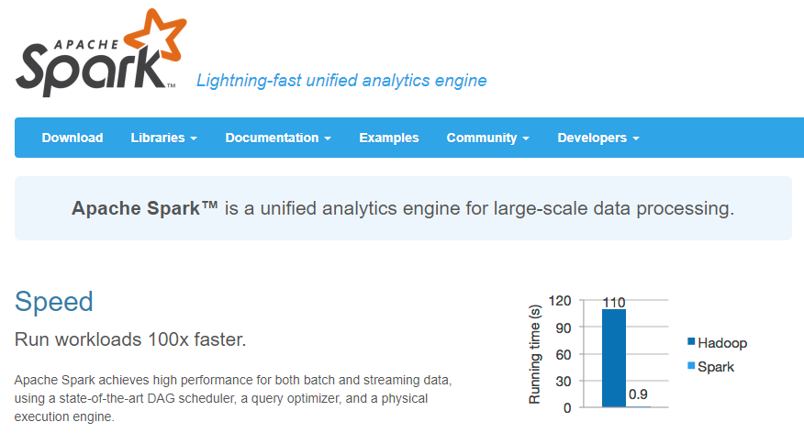
What is Spark?
Think… “In-memory Hadoop”
Notes:
Spark is an Apache project. Apache itself defines Spark as a “lightning-fast unified analytics engine.” A good way to begin getting your head around Spark is to think of it as “in-memory Hadoop,” because it is great for performing map-reduce-centric manipulation of very large data sets.
<CLICK> In fact, Apache highlights this by comparing itself to Hadoop, and noting that Spark is 100 times faster.

Slide 7
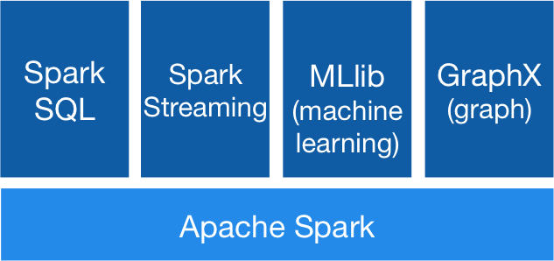
What is Spark?
Notes:
More specifically, Spark is a general-purpose analytics programming platform that consists of four libraries: SQL, Streaming, Machine Learning, and Graph Analytics. These libraries may be used separately or combined seamlessly.

Slide 8
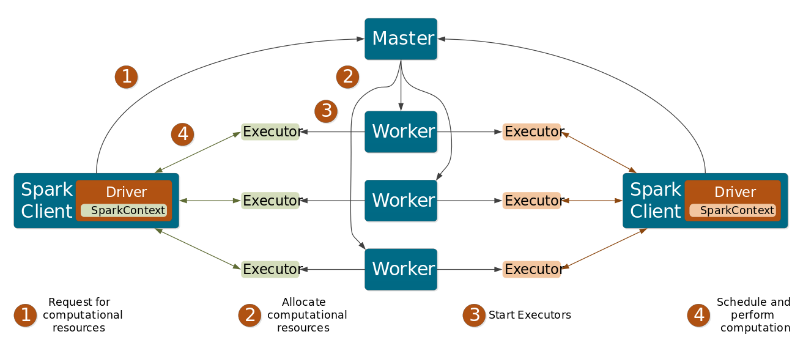
How does Spark work?
Notes:
Even though Spark is very fast, it uses a batch paradigm to process data on clusters of machines.
<CLICK> Clients make a request for compute resources to the Spark Master node.

Slide 9
How does Spark work?
Notes:
The master node assigns workers on the cluster.

Slide 10
How does Spark work?
Notes:
Workers assign executors for specific tasks.

Slide 11
How does Spark work?
Notes:
Executors perform the actual computing tasks and return results directly to the client.

Slide 12

Why is Spark important in DSE?
Time
Spark
Batch
ETL
Periodic Batch
Hourly roll-ups
Interactive
Business Intelligence
Streaming
Filtering, roll-ups
Notes:
An Analytics capability is a crucial addition to core Cassandra capabilities. Cassandra is the worlds’ best database for high-speed, high-volume OLTP needs. However, large enterprise applications also have other related needs that Cassandra is not designed to solve.
Some of the most important of these analytic needs are shown here, in descending order of the time they consume. First, large-scale data movement between external systems and Cassandra is a very common enterprise need. This type of use case is often called Extract-Transform-Load, or ETL.
Smaller-scale data manipulation in terms of periodic batch jobs is also a common need. For example, imagine a retail web site where consumers write reviews of products. Cassandra is well-suited to handle this use case. However, we also typically want to provide an *average* review rating that aggregates all reviews for a product. In this case, we will need a periodic batch job that performs this aggregation, which is poorly suited to the capabilities of core Cassandra.
Next we have the need for Interactive ad hoc queries, often executed by Business Analysts and Data Scientists. As we shall see, AlwaysOnSQL falls into this category. Core Cassandra provides excellent response times for pre-planned queries, but is not well-suited to ad hoc query requirements, which may require traversal of all nodes on a cluster. Spark fills this need.
Finally, many use cases require Cassandra to ingest streaming data from external systems. Again, Spark is an excellent choice for this type of use case.

Slide 13
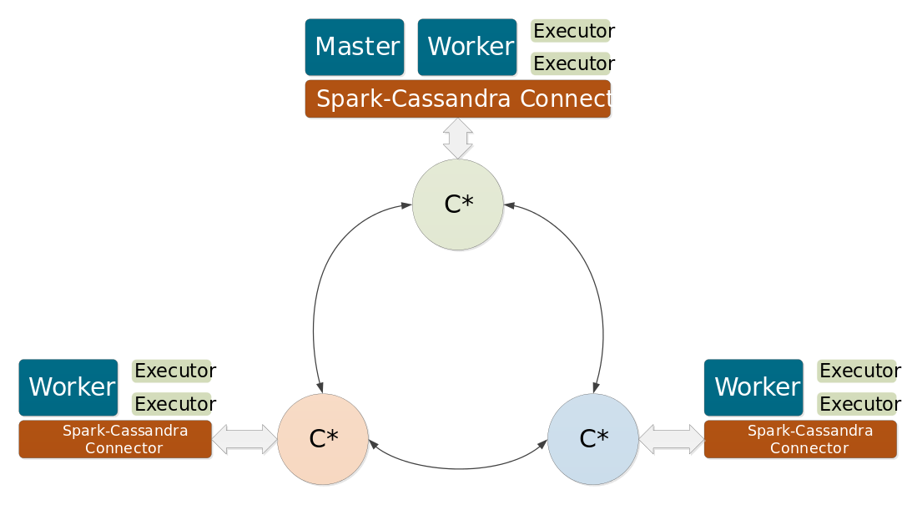
How does AlwaysOnSQL work?
Notes:
DataStax built its Analytics capability by tightly integrating Spark with Cassandra. The Spark Master is managed by DSE, and a new Master is automatically elected if the existing Master node goes down. In addition, integration between Cassandra tables and Spark data structures is seamless.
The special capability of AlwaysOnSQL is possible because DSE allocates a set of Spark Workers that are always running and listening for new client connections from standard JDBC and ODBC client drivers. These workers use the power of Spark SQL to satisfy client requests. This means that Business Analysts can continue using their favorite data visualization tools for Cassandra data. In addition, DSE governs concurrent requests from these connections to ensure that a burst of client requests do not affect performance.

Slide 14
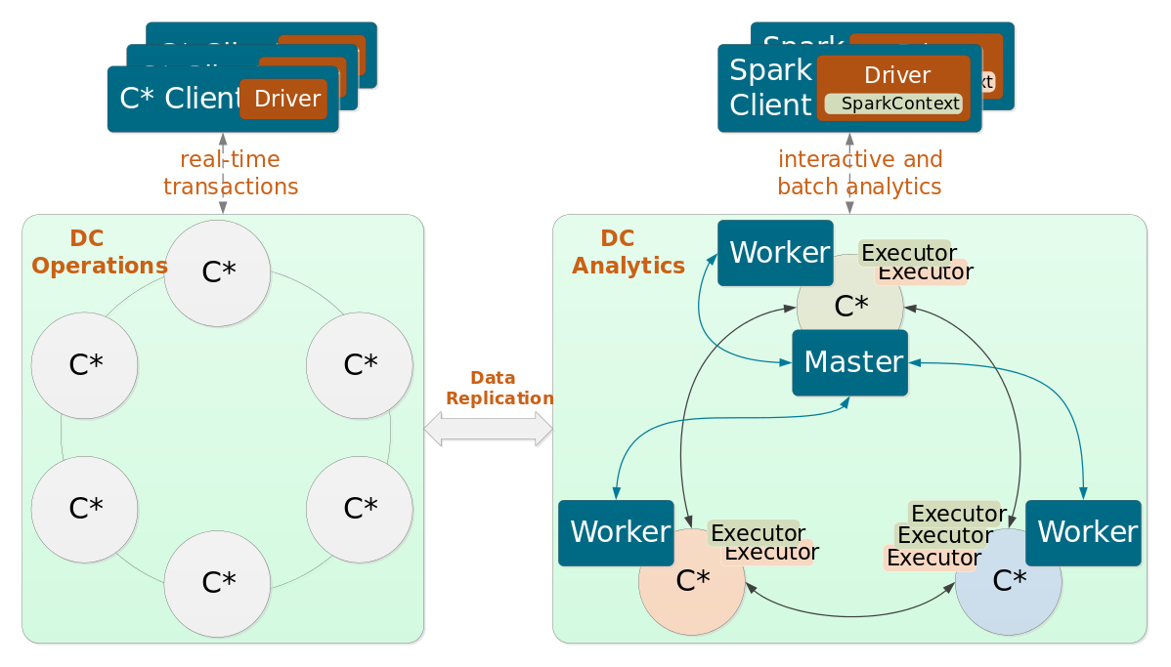
How does AlwaysOnSQL work?
Notes:
Finally, let’s take note of an architecture choice that is commonly with with DSE Analytics and AlwaysOnSQL. Here we see a DSE cluster that is divided into two data centers, named Operations and Analytics. The Operations data center runs Core DSE, perhaps with Search enabled. However, it does not run Analytics. Most real-time users connect to this data center.
The Analytics data center runs Spark, including AlwaysOnSQL. This ensures that complex Analytics jobs do not impact performance in the Operations data center. Note, however, that data is still seamlessly replicated across both data centers.

Slide 15
Agenda
Time | Topic
1:00 | Introductions
1:15 | Overview of DataStax Enterprise
1:35 | Just Enough Internals
1:50 | The Reference Application
1:55 | Accessing the Instances
2:00 | Lab 1
Time | Topic
2:30 | Lab 2
2:50 | Lab 3
3:10 | Lab 4
3:30 | Going Deeper
3:35 | Discussion
B
R
E
A
K
Notes:
Here is our agenda (NOTE that the actual times may have to be changed, depending on the specific workshop needs).
We’ll begin by getting to know each other a little. Then we’ll provide a level-set on DataStax Enterprise, or DSE, for those who are new to the platform (NOTE: this is a separate deck, available on Gdrive in the same directory as this deck). Then I’ll introduce the bare minimum we’ll need to understand about DSE and AlwaysOnSQL internals. We’ll talk briefly about our imaginary reference application. Then we’ll take a brief tour of the resources we’ll be using today, including our Cluster Instance and DSE Notebooks.
From there we’ll jump into four Lab exercises, where you’ll be hands-on with the product, and we’ll wrestle with some real-world AlwaysOnSQL problems.
After the labs I’ll share some useful links, and we’ll end the day with discussion about anything that is top-of-mind for you.

Slide 16
RightVest
Ethical Investing has traditionally been difficult and costly…
Each investor has a different set of ethical concerns
It is difficult to verify that investment vehicles actually live up to their ethical claims
Until now, it has only been available to very wealthy clients
RightVest uses automation to make Ethical Investings available to the small investor…
They built Etho-Tron, which uses machine learning to…
Ingest a wide range of news feeds, social media, etc.
Continually monitor and update ethical ratings across 11 different areas of concern
Investors build and maintain portfolios based on their personal choices
As ratings change, investors can monitor and manage their investments
Notes:
We are all imaginary employees of an Investment Management firm called RightVest. RightVest aims to disrupt the market for Ethical Investing. Ethical Investing is a term used by investors who want to avoid investing in businesses that they perceive as acting in some anti-social manner. For example, some investors want avoid businesses that do not treat animals humanely. Some want to avoid tobacco businesses, or weapon businesses, and so on.
And that’s what makes Ethical Investing so hard. Every investor has a different set of concerns. It’s also very difficult to determine how businesses stack up against each of these ethical concerns, especially as things change over time. Because of the high degree of manual effort involved, Ethical Investing today is generally limited to very wealthy investors, because the cost of customer service is so high.
<CLICK> RightVest aims to change all that. They have invested millions in building a software application called Etho-Tron. Etho-Tron uses machine learning to continually ingest news feeds, social media, and so on, in order to monitor and update ethical ratings of all investment vehicles. Each investment vehicle is rated across 11 areas of concern, on a scale from 1 (least compliant) to 5 (most compliant).
<CLICK> Investors work with Customer Service Reps to build portfolios. As ratings change, though, some investment vehicles become non-compliant with the investor’s desires. We have to detect these conditions and provide a way for investors to re-balance their portfolios.

Slide 17
Agenda
Time | Topic
1:00 | Introductions
1:15 | Overview of DataStax Enterprise
1:35 | Just Enough Internals
1:50 | The Reference Application
1:55 | Accessing the Instances
2:00 | Lab 1
Time | Topic
2:30 | Lab 2
2:50 | Lab 3
3:10 | Lab 4
3:30 | Going Deeper
3:35 | Discussion
B
R
E
A
K
Notes:
Here is our agenda (NOTE that the actual times may have to be changed, depending on the specific workshop needs).
We’ll begin by getting to know each other a little. Then we’ll provide a level-set on DataStax Enterprise, or DSE, for those who are new to the platform (NOTE: this is a separate deck, available on Gdrive in the same directory as this deck). Then I’ll introduce the bare minimum we’ll need to understand about DSE and AlwaysOnSQL internals. We’ll talk briefly about our imaginary reference application. Then we’ll take a brief tour of the resources we’ll be using today, including our Cluster Instance and DSE Notebooks.
From there we’ll jump into four Lab exercises, where you’ll be hands-on with the product, and we’ll wrestle with some real-world AlwaysOnSQL problems.
After the labs I’ll share some useful links, and we’ll end the day with discussion about anything that is top-of-mind for you.

Slide 18
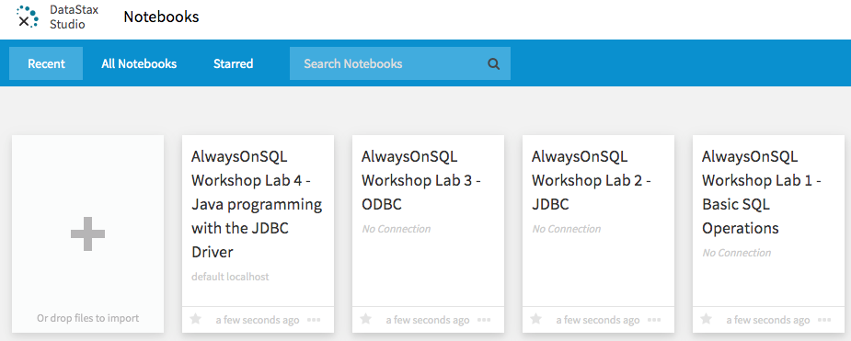
DSE Cluster and Studio
Notes:
You all have access to a cluster that holds the labs. This cluster has DSE installed.
We also have DSE Studio installed. This is a Notebook application that lets us build and test queries.

Slide 19
DSE Cluster and Studio
NOTE: Don’t worry if you get this message when you open a notebook. We’ll simple click “Edit Connection” and change the host from default localhost to node0

Slide 20
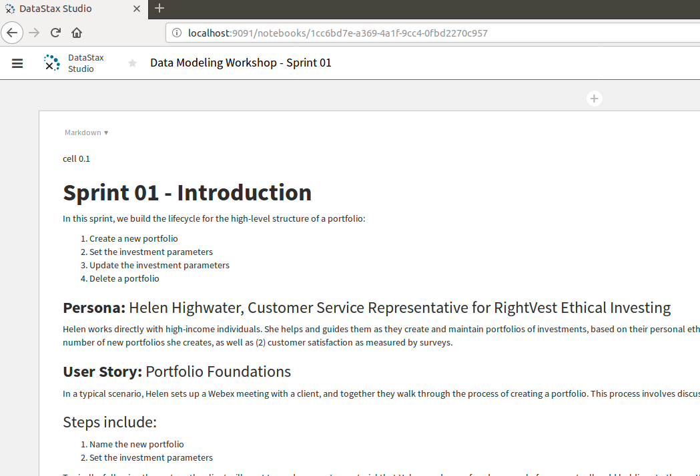
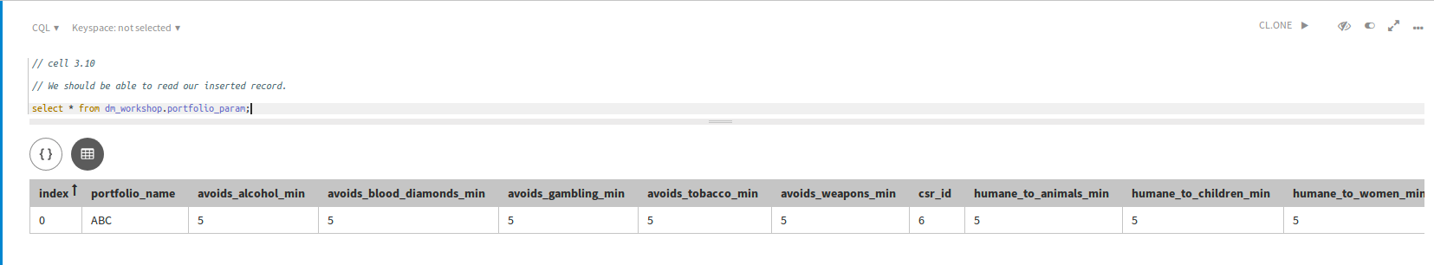
DSE Cluster and Studio
2. Execute
1. Enter CQL statements
3. View results
Notes:
Notebooks contain cells with instructions…
<CLICK> As well as cells for Cassandra Query Language operations.

Slide 21
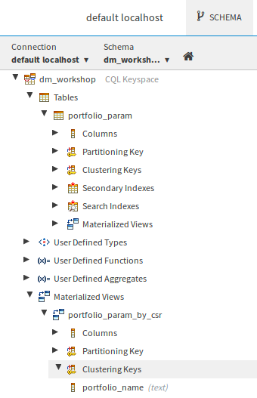
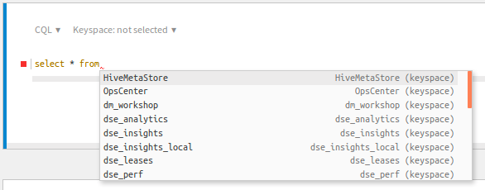
DSE Cluster and Studio
Notes:
Studio has some sophisticated features. For example, you can use CTRL-Space to get intelli-type capabilities.
<CLICK> There is also a Schema button that provides details about the schemas we are building in the labs.
One word of warning… Studio works with the latest version of DSE that we are using, but it sometimes gives some false error messages, regarding things that would not have worked in earlier versions.

Slide 22
Agenda
Time | Topic
1:00 | Introductions
1:15 | Overview of DataStax Enterprise
1:35 | Just Enough Internals
1:50 | The Reference Application
1:55 | Accessing the Instances
2:00 | Lab 1
Time | Topic
2:30 | Lab 2
2:50 | Lab 3
3:10 | Lab 4
3:30 | Going Deeper
3:35 | Discussion
B
R
E
A
K
Notes:
Here is our agenda (NOTE that the actual times may have to be changed, depending on the specific workshop needs).
We’ll begin by getting to know each other a little. Then we’ll provide a level-set on DataStax Enterprise, or DSE, for those who are new to the platform (NOTE: this is a separate deck, available on Gdrive in the same directory as this deck). Then I’ll introduce the bare minimum we’ll need to understand about DSE and AlwaysOnSQL internals. We’ll talk briefly about our imaginary reference application. Then we’ll take a brief tour of the resources we’ll be using today, including our Cluster Instance and DSE Notebooks.
From there we’ll jump into four Lab exercises, where you’ll be hands-on with the product, and we’ll wrestle with some real-world AlwaysOnSQL problems.
After the labs I’ll share some useful links, and we’ll end the day with discussion about anything that is top-of-mind for you.

Slide 23
Agenda
Time | Topic
1:00 | Introductions
1:15 | Overview of DataStax Enterprise
1:35 | Just Enough Internals
1:50 | The Reference Application
1:55 | Accessing the Instances
2:00 | Lab 1
Time | Topic
2:30 | Lab 2
2:50 | Lab 3
3:10 | Lab 4
3:30 | Going Deeper
3:35 | Discussion
B
R
E
A
K
Notes:
Here is our agenda (NOTE that the actual times may have to be changed, depending on the specific workshop needs).
We’ll begin by getting to know each other a little. Then we’ll provide a level-set on DataStax Enterprise, or DSE, for those who are new to the platform (NOTE: this is a separate deck, available on Gdrive in the same directory as this deck). Then I’ll introduce the bare minimum we’ll need to understand about DSE and AlwaysOnSQL internals. We’ll talk briefly about our imaginary reference application. Then we’ll take a brief tour of the resources we’ll be using today, including our Cluster Instance and DSE Notebooks.
From there we’ll jump into four Lab exercises, where you’ll be hands-on with the product, and we’ll wrestle with some real-world AlwaysOnSQL problems.
After the labs I’ll share some useful links, and we’ll end the day with discussion about anything that is top-of-mind for you.

Slide 24
Agenda
Time | Topic
1:00 | Introductions
1:15 | Overview of DataStax Enterprise
1:35 | Just Enough Internals
1:50 | The Reference Application
1:55 | Accessing the Instances
2:00 | Lab 1
Time | Topic
2:30 | Lab 2
2:50 | Lab 3
3:10 | Lab 4
3:30 | Going Deeper
3:30 | Discussion
B
R
E
A
K
Notes:
Here is our agenda (NOTE that the actual times may have to be changed, depending on the specific workshop needs).
We’ll begin by getting to know each other a little. Then we’ll provide a level-set on DataStax Enterprise, or DSE, for those who are new to the platform (NOTE: this is a separate deck, available on Gdrive in the same directory as this deck). Then I’ll introduce the bare minimum we’ll need to understand about DSE and AlwaysOnSQL internals. We’ll talk briefly about our imaginary reference application. Then we’ll take a brief tour of the resources we’ll be using today, including our Cluster Instance and DSE Notebooks.
From there we’ll jump into four Lab exercises, where you’ll be hands-on with the product, and we’ll wrestle with some real-world AlwaysOnSQL problems.
After the labs I’ll share some useful links, and we’ll end the day with discussion about anything that is top-of-mind for you.

Slide 25
Going Deeper
DataStax Developer Guide: https://docs.datastax.com/en/dse/6.0/dse-dev/datastax_enterprise/spark/alwaysOnSql.html
Authentication with AlwaysOnSQL: https://docs.datastax.com/en/dse/6.0/dse-dev/datastax_enterprise/spark/authAlwaysOnSql.html
Notes:
These resources will help you go deeper on AlwaysOnSQL.

Slide 26









Discussion
Your Datacenter
Masterless and Active Everywhere Database
Contextual
Always-On
Real-Time
Distributed
Scalable
Notes:
Q&A

Slide 27
Thank you!
Notes:
Thank you.

